Slide 1
T1D Beta diversity update
Jochum, Michael D.
21 July 2022

Slide 2
Objective : Rerun the beta diversity analyses using phylogenetic distances instead of just bray-curtis
Analysis Steps:
Make a phylogenetic distance tree of the taxa
Analyze dissimilarity using phylogenetic distance via:
Weighted UNIFRAC
Unweighted UNIFRAC
Run adonis permutational ANOVA
Especially look for significance across neonatal samples Ear and Stool by:
Disease
Delivery mode
Maternal 1st Trimester HbA1C values
impute NA values for T1d patients based on knn algo
Generate a norm distribution of healthy 1st Trimester HbA1C values for the Control patients
Make new dimensional reduction PCoA figures using the Unifrac distance scores
Annotate figured with the adonis permanova pvalue scores
Update 21 July 2022

Slide 4
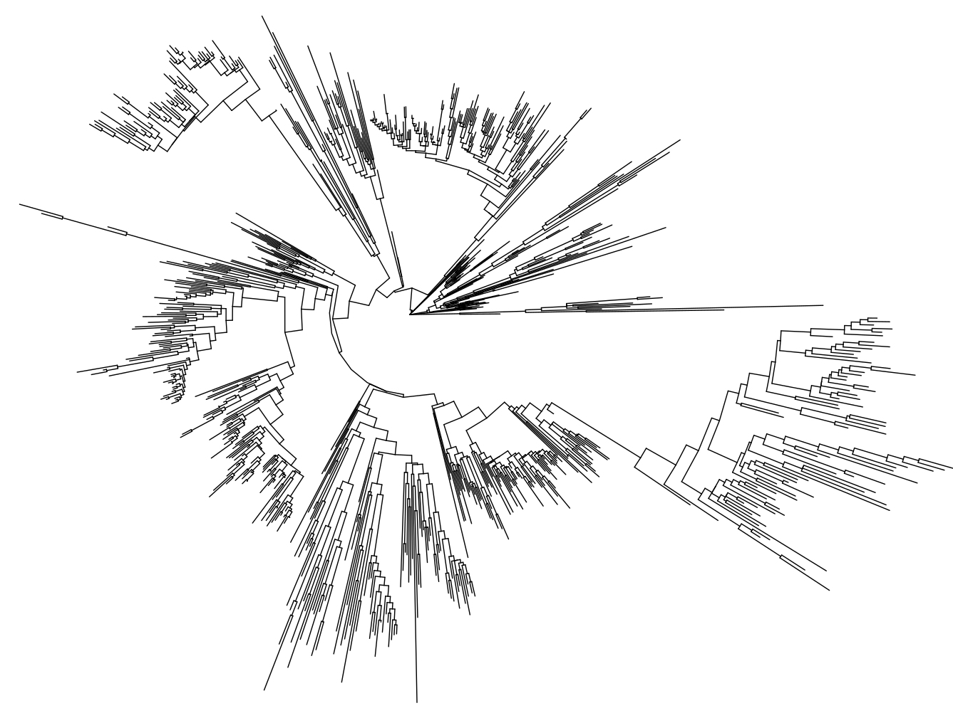
Make a phylogenetic distance tree of the taxa
overview of phylogenetic distances for all samples based on ASV fasta sequence alignment optimal model fit
2683 tips and 2681 internal nodes

Slide 5
Analyze dissimilarity using phylogenetic distance
Neonate Weighted UNIFRAC
Neonate Unweighted UNIFRAC
Weighted Unifrac | Df | SumOfSqs | R2 | F | Pr(>F)
disease | 1 | 0.0002 | 0.0062 | 1.141 | 0.2991
SampleType | 1 | 0.0036 | 0.129 | 23.82 | 0.0001 | ***
Delivery | 1 | 0.00043 | 0.0155 | 2.86 | 0.007 | **
1st Trim HbA1C | 1 | 0.00035 | 0.0127 | 2.33 | 0.035 | *
Residual | 153 | 0.0231 | 0.829
Total | 158 | 0.02782 | 1
Unweighted UniFrac | Df | SumOfSqs | R2 | F | Pr(>F)
disease | 1 | 0.643 | 0.00846 | 1.3816 | 0.0076 | **
SampleType | 1 | 1.955 | 0.02572 | 4.2013 | 0.0001 | ***
Delivery | 1 | 0.971 | 0.01277 | 2.0858 | 0.0001 | ***
1st Trim HbA1C | 1 | 0.476 | 0.00626 | 1.0225 | 0.3568
Residual | 153 | 71.204 | 0.93681
Total | 158 | 76.007 | 1
Maternal Weighted UNIFRAC
Maternal Unweighted UNIFRAC
Weighted Unifrac | Df | SumOfSqs | R2 | F | Pr(>F)
disease | 1 | 0.0004 | 0.004 | 2.415 | 0.0613 | .
HbA1C_1trym_2 | 1 | 0.0002 | 0.002 | 0.862 | 0.427
Delivery | 1 | 0.0002 | 0.003 | 1.477 | 0.178
SampleType | 3 | 0.0329 | 0.374 | 72.807 | 0.0001 | ***
patient | 1 | 0.0007 | 0.008 | 4.89 | 0.004 | **
Residual | 356 | 0.0536 | 0.609
Total | 363 | 0.0879 | 1
Unweighted UniFrac | Df | SumOfSqs | R2 | F | Pr(>F)
disease | 1 | 0.947 | 0.00546 | 2.0423 | 0.0001 | ***
SampleType | 3 | 5.727 | 0.03304 | 4.1178 | 0.0001 | ***
Delivery | 1 | 0.623 | 0.0036 | 1.3442 | 0.0255 | *
1st Trim HbA1C | 1 | 0.523 | 0.00302 | 1.1291 | 0.1598
Residual | 357 | 165.489 | 0.95488
Total | 363 | 173.309 | 1
---

Slide 6
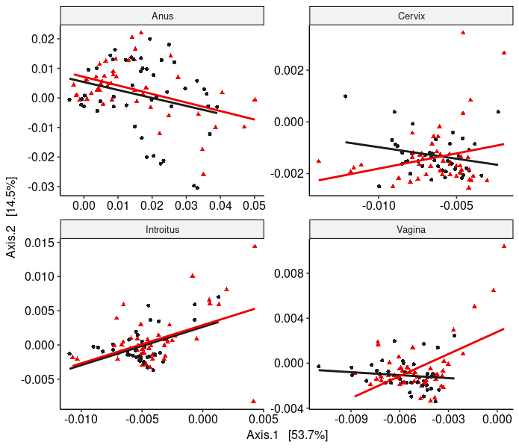
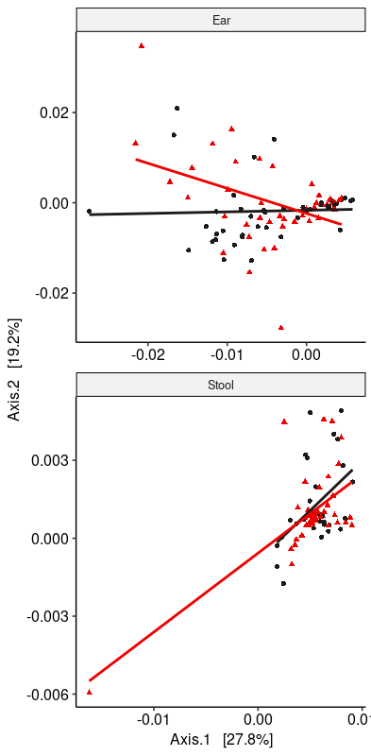
Neonate Weighted UNIFRAC pcoa plots
Maternal Weighted UNIFRAC pcoa plots
p = 0.1143

Slide 7
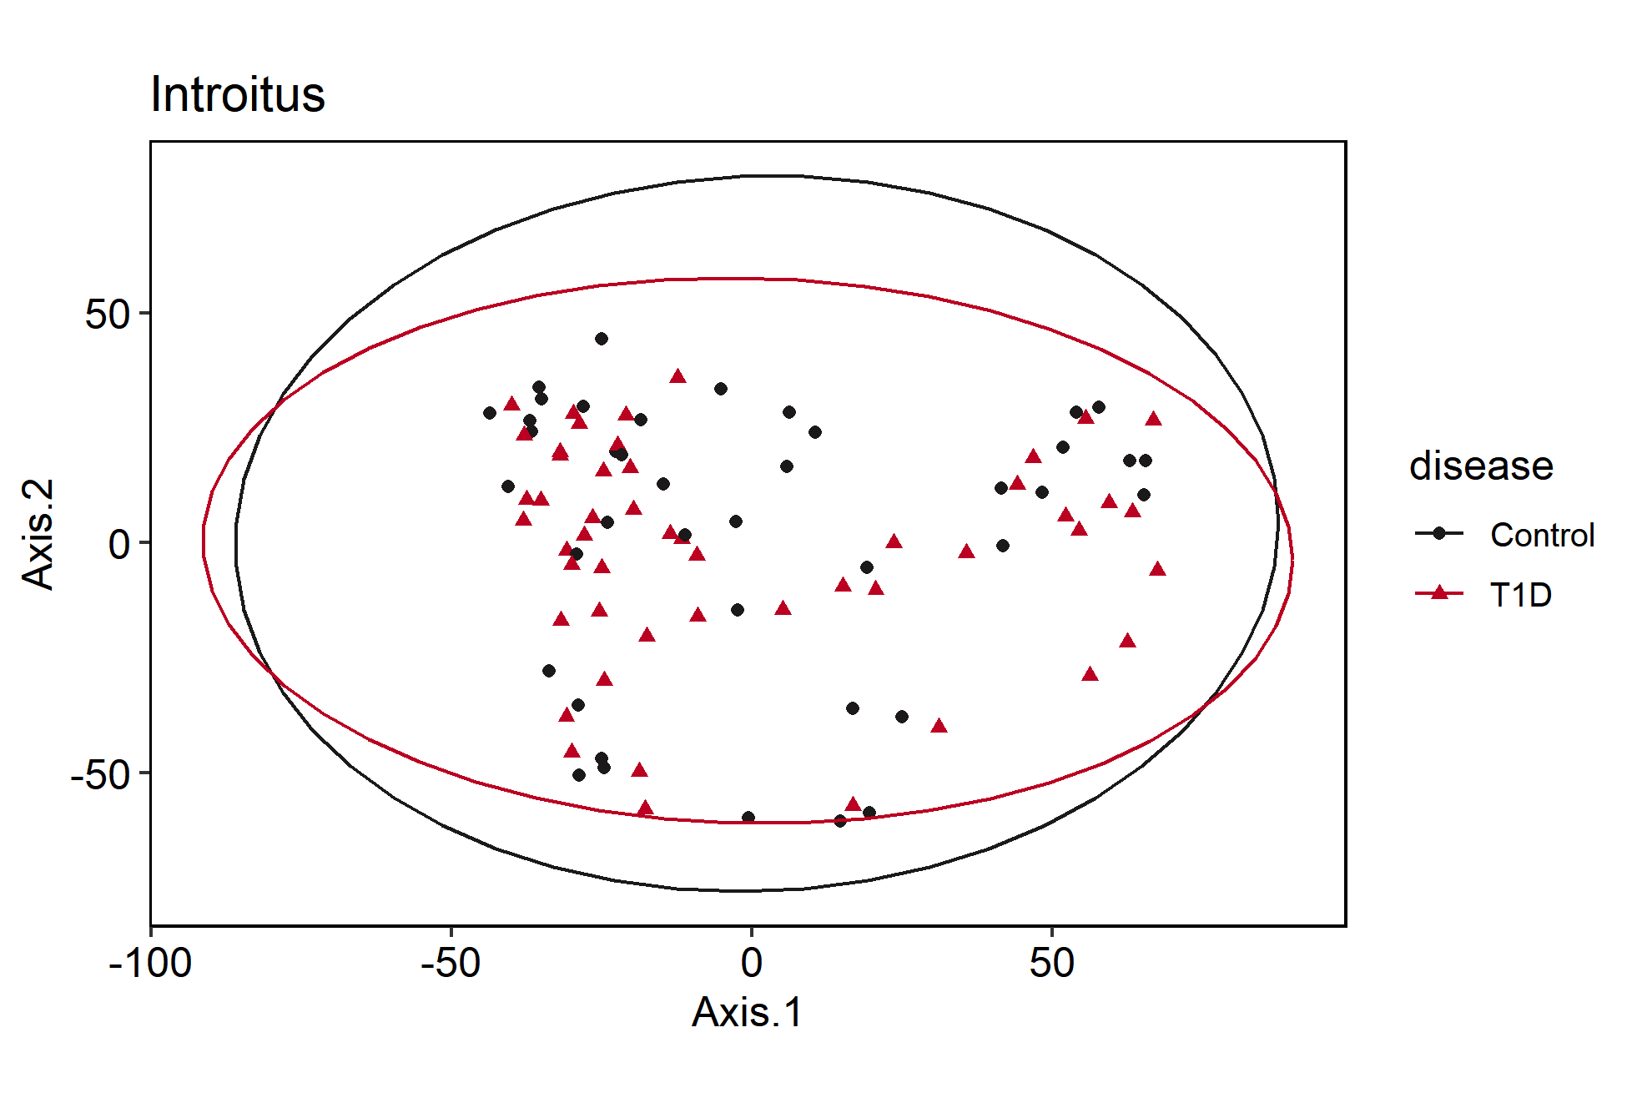
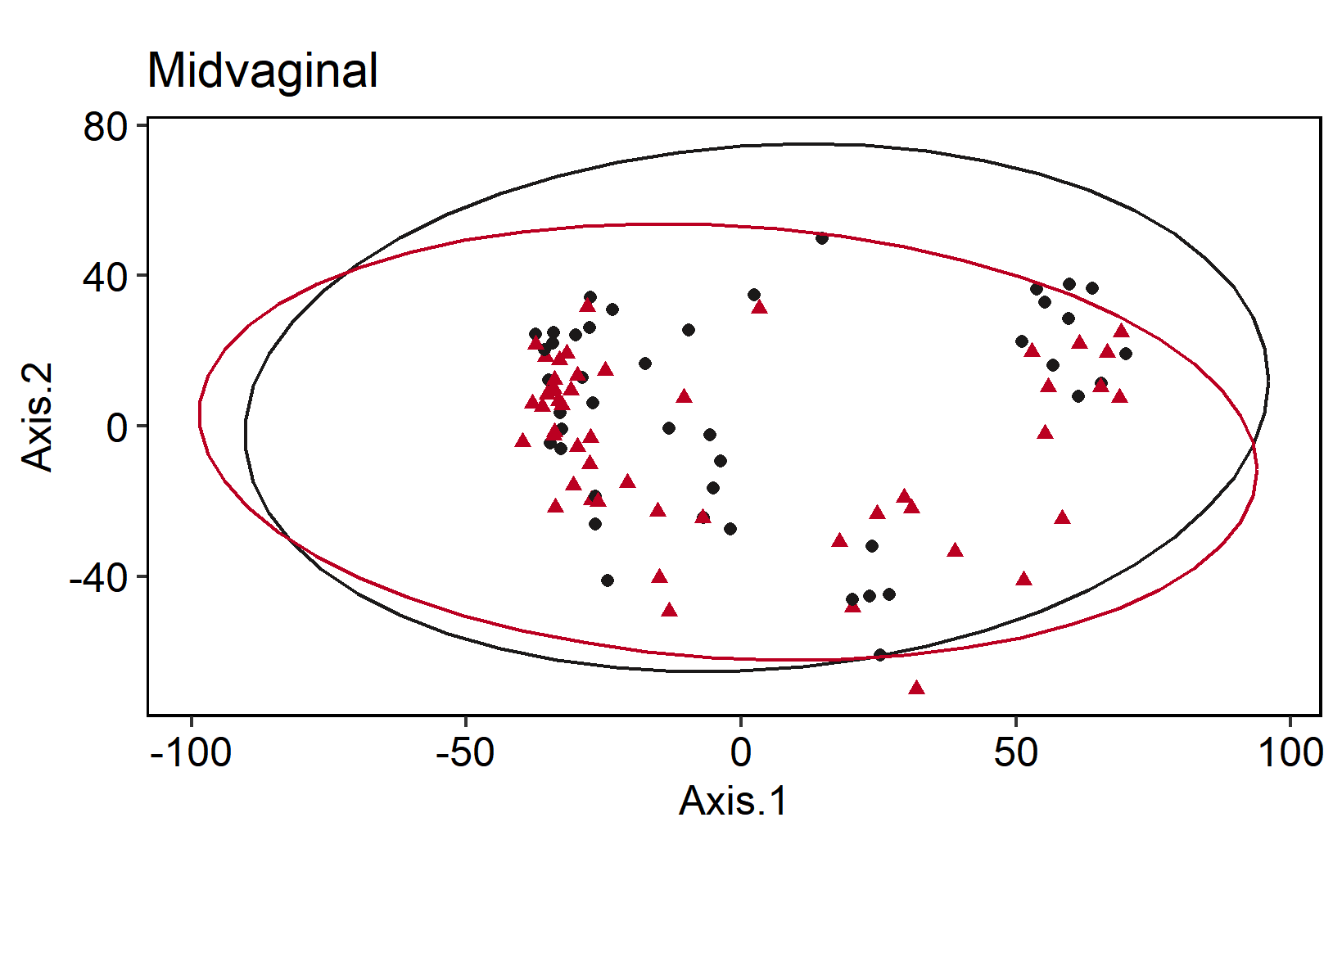
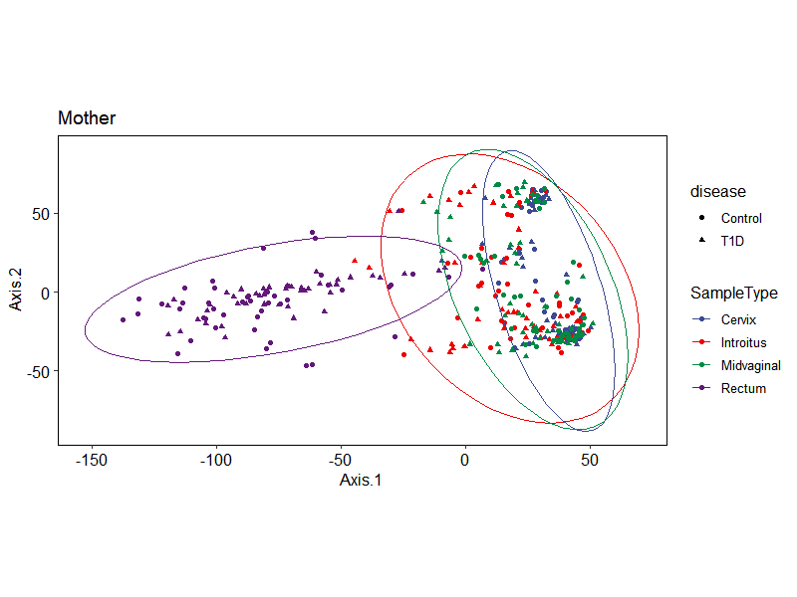
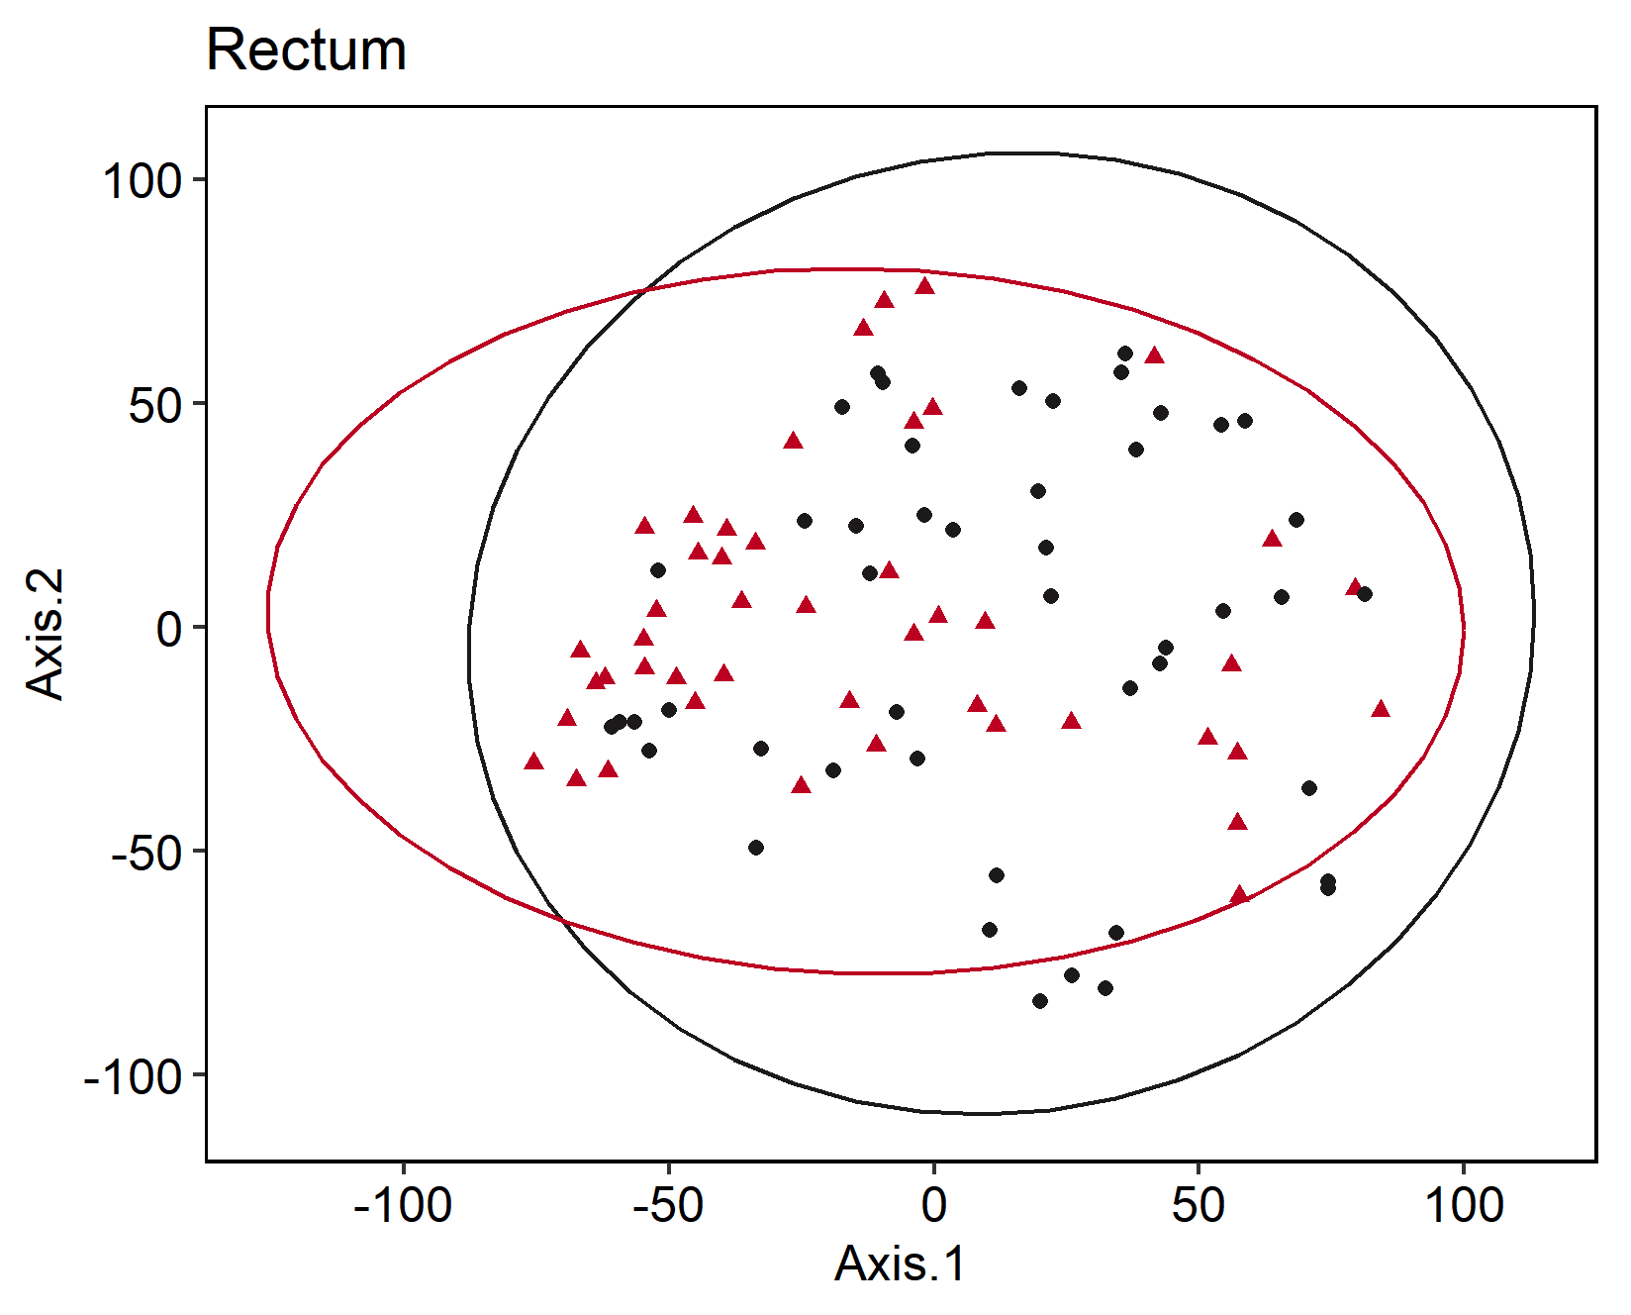
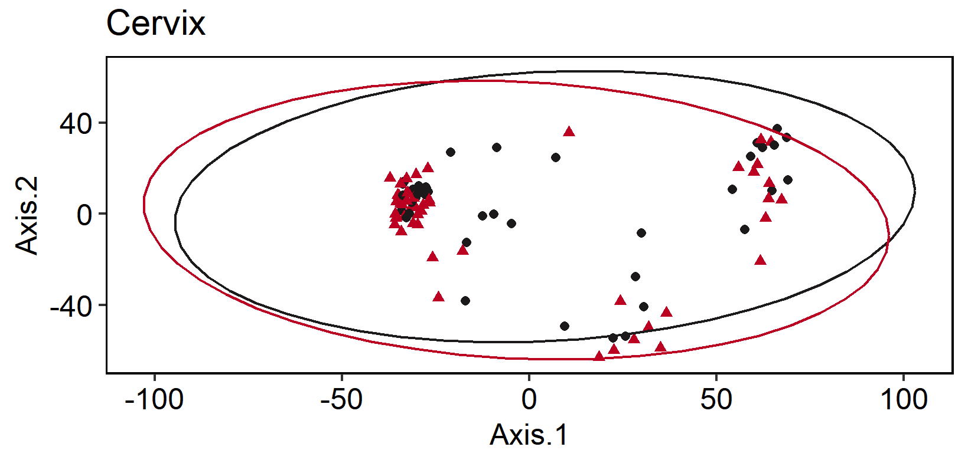
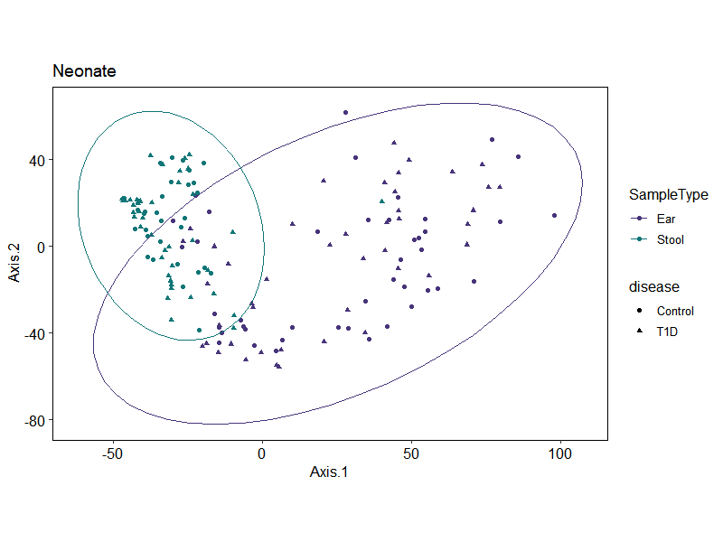
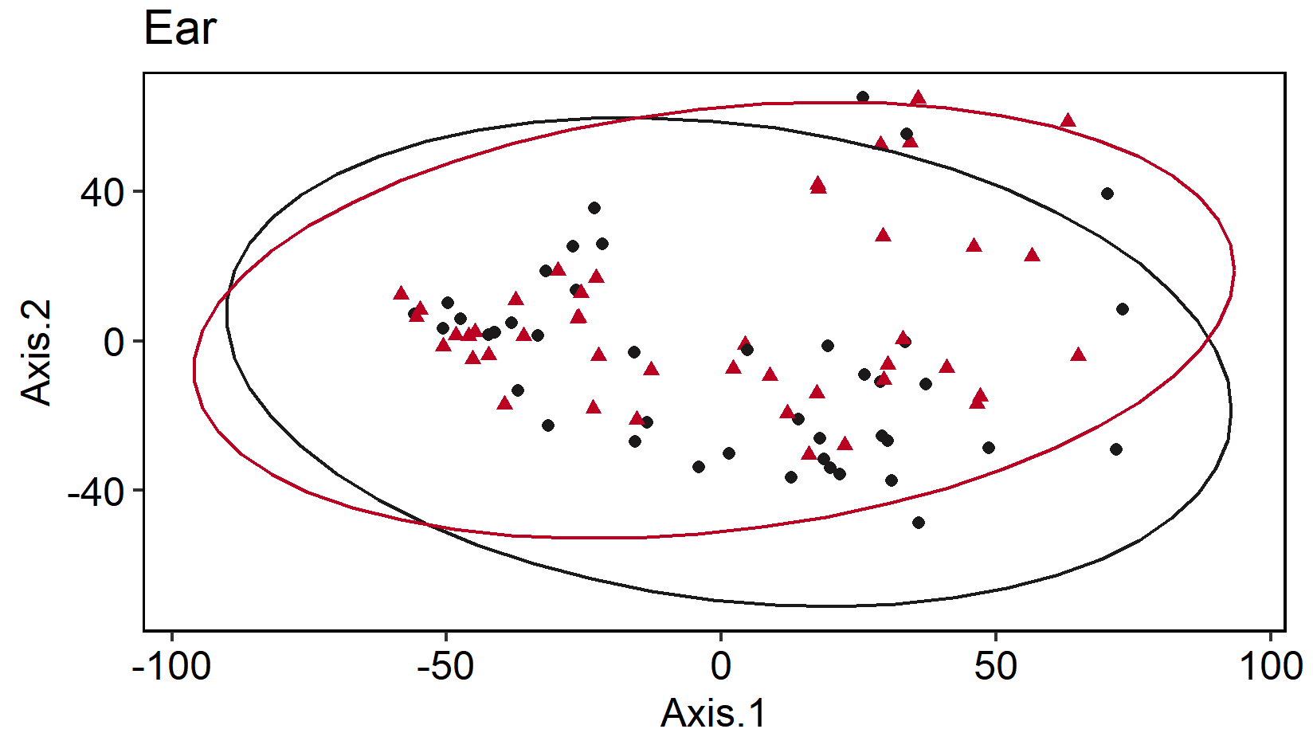
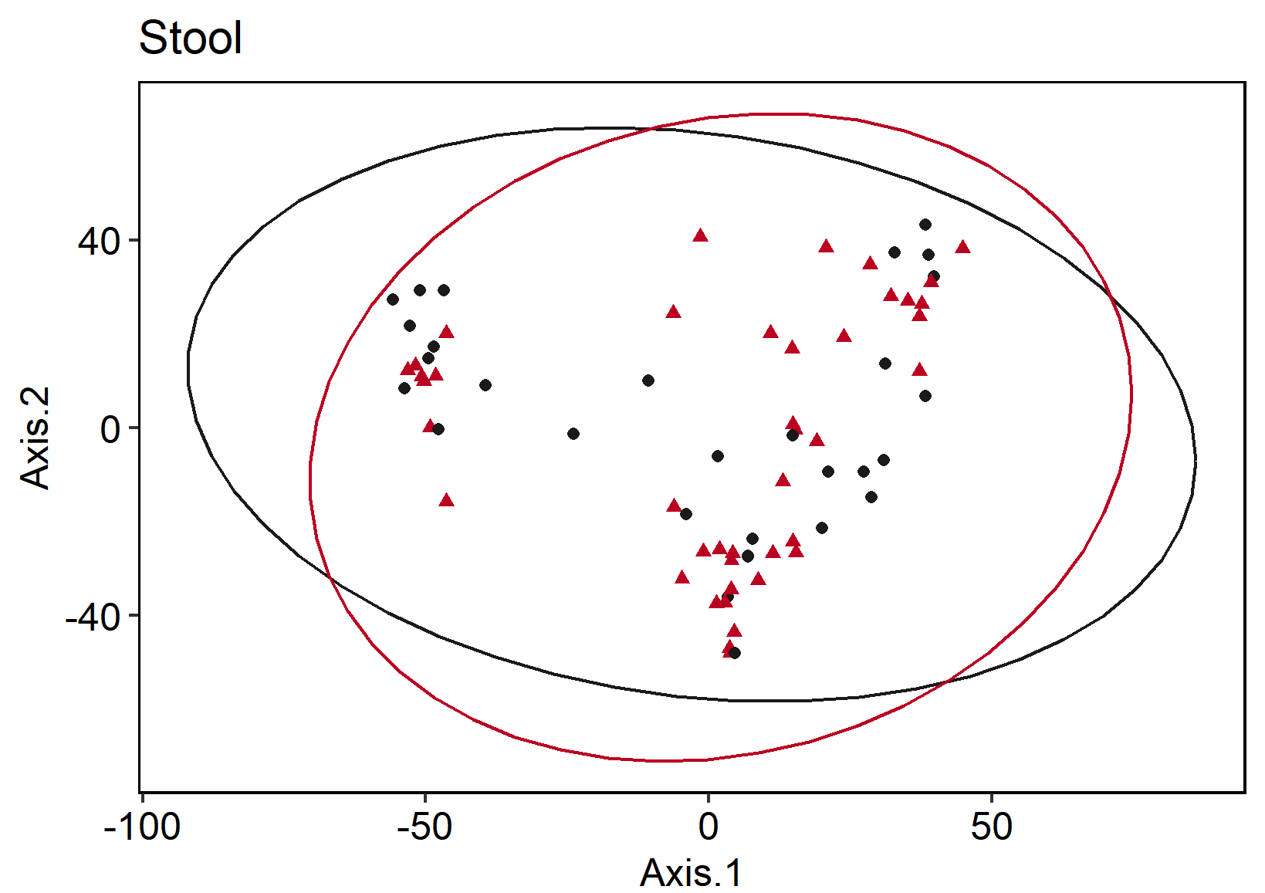
A
C
D
> list
# A tibble: 6 x 1
SampleType
<chr>
1 Anus
2 Cervix
3 Ear
4 Introitus
5 Stool
6 Vagina
> lapply(list$SampleType, function(X) day_adonis(X = X))
[[1]]
Permutation test for adonis under reduced model
Terms added sequentially (first to last)
Permutation: free
Number of permutations: 9999
adonis2(formula = Day_unifrac ~ disease, data = Day_meta, permutations = 9999, parallel = T)
Df SumOfSqs R2 F Pr(>F)
disease 1 10634.7 0.87192 619.51 0.1594
Residual 91 1562.1 0.12808
Total 92 12196.8 1.00000
[[2]]
Permutation test for adonis under reduced model
Terms added sequentially (first to last)
Permutation: free
Number of permutations: 9999
adonis2(formula = Day_unifrac ~ disease, data = Day_meta, permutations = 9999, parallel = T)
Df SumOfSqs R2 F Pr(>F)
disease 1 -5122 -0.07318 -6.0687 0.6145
Residual 89 75122 1.07318
Total 90 70000 1.00000
[[3]]
Permutation test for adonis under reduced model
Terms added sequentially (first to last)
Permutation: free
Number of permutations: 9999
adonis2(formula = Day_unifrac ~ disease, data = Day_meta, permutations = 9999, parallel = T)
Df SumOfSqs R2 F Pr(>F)
disease 1 -1034.0 -0.65223 -33.554 0.8989
Residual 85 2619.2 1.65223
Total 86 1585.2 1.00000
[[4]]
Permutation test for adonis under reduced model
Terms added sequentially (first to last)
Permutation: free
Number of permutations: 9999
adonis2(formula = Day_unifrac ~ disease, data = Day_meta, permutations = 9999, parallel = T)
Df SumOfSqs R2 F Pr(>F)
disease 1 -475.9 -0.0757 -6.2634 0.5513
Residual 89 6762.1 1.0757
Total 90 6286.3 1.0000
[[5]]
Permutation test for adonis under reduced model
Terms added sequentially (first to last)
Permutation: free
Number of permutations: 9999
adonis2(formula = Day_unifrac ~ disease, data = Day_meta, permutations = 9999, parallel = T)
Df SumOfSqs R2 F Pr(>F)
disease 1 181.88 0.41143 48.932 0.0741 .
Residual 70 260.20 0.58857
Total 71 442.08 1.00000
---
Signif. codes: 0 ‘***’ 0.001 ‘**’ 0.01 ‘*’ 0.05 ‘.’ 0.1 ‘ ’ 1
[[6]]
Permutation test for adonis under reduced model
Terms added sequentially (first to last)
Permutation: free
Number of permutations: 9999
adonis2(formula = Day_unifrac ~ disease, data = Day_meta, permutations = 9999, parallel = T)
Df SumOfSqs R2 F Pr(>F)
disease 1 -1783.5 -0.55289 -32.4 0.9332
Residual 91 5009.2 1.55289
Total 92 3225.8 1.00000
p = 0.933
p = 0.551
F
Maternal
E
p = 0.615
G
p = 0.159
B
p = 0.899
Neonatal
H
p = 0.074
Supplemental Figure 8. Beta Diversity PCoA plots comparing microbiome composition based on variance stabilizing transformed (VST) Euclidean distances in A) Maternal (top) and B) Neonatal (bottom) microbiomes faceted by maternal sample types C) Vaginal Introitus; D) Midvaginal; E) Cervix; F) Rectum; and neonatal sample types G) Ear; and H) Stool. Samples are shaped by disease state and colored by sample type in panels A and B, or disease state in panels C-H where Type 1 diabetic microbiomes are depicted in red and control samples are depicted in black. P values significance scores located in the bottom left of each plot were conducted using an adonis permutational ANOVA test comparing ASV counts against disease state (perm= 9999).

